Slide 1
Introduction And Present Condition
Traditional rules
Paperwork based
Manual Services
Unfriendly System

Slide 2
Our system
RFID based personal health card :
store health information
current health condition
drug administration
medical providers
contact people.

Slide 3
Our system
RFID based personal health card :
exploring nearby emergency places
route and direction
User-friendly interface
Light weight
Easy to use
Secured and Confidential

Slide 4
Related Work
Belal Chowdhury, Rajiv Khosla (2007)
RFID-based wristband
transmit and receive data .
patients safety
Eliminating paper-based document
System interaction.
Costly and , could be job threaten

Slide 5
Cristina TURCU, Cornel TURCU
Personal electronic record Identity Card (PIC)
storing data
electronic health care record.
Accurate information
secured against the editing and deletion by unauthorized personnel

Slide 6
Lina and Yang
Three-layer electronic record management
Expandable
maintainable
secure and cost-effective.
database flexibility
provides wide range detection & Mobility detection.

Slide 7
Lash Mapa and Kishan Saha
Wristband monitoring .
RFID framework : procedure, admission, waiting, nurse exam, appointment.
No emergency health services for critical situation of outpatients or how to handle patients.

Slide 8
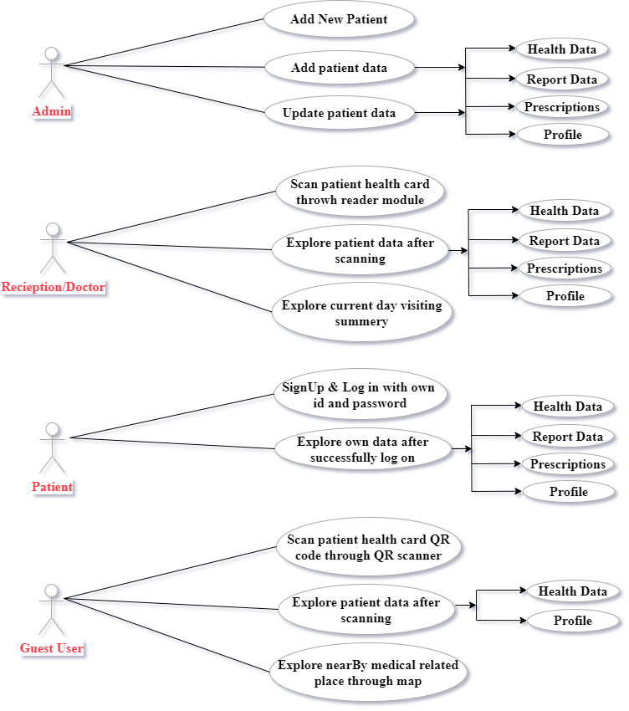
Figure 3.1: Our System Use case Diagram

Slide 9
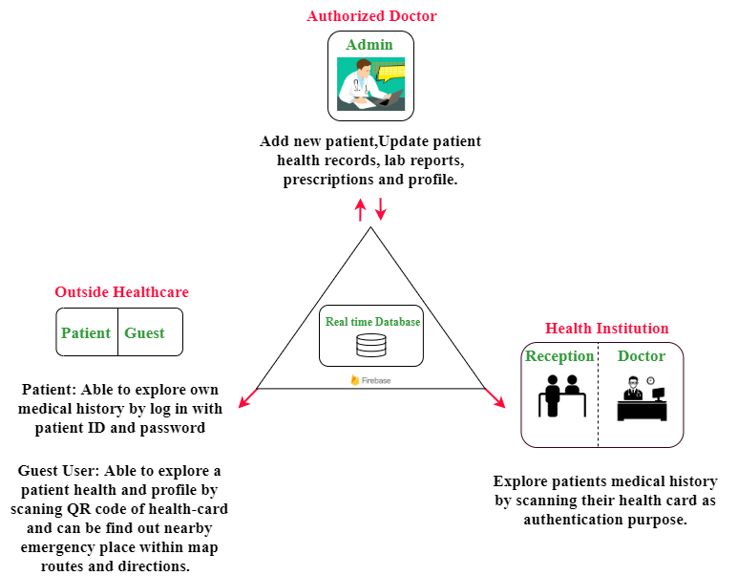
Figure 3.2: System Overview

Slide 10
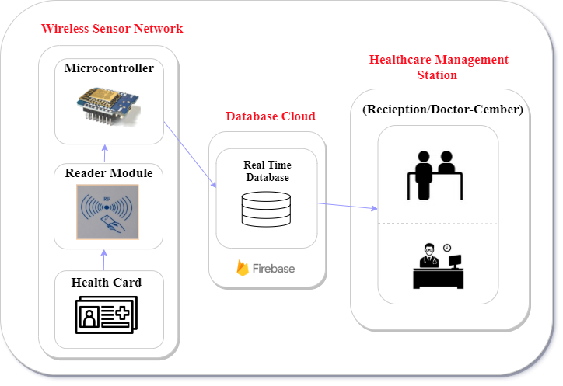
Figure 3.2: System Overview

Slide 11
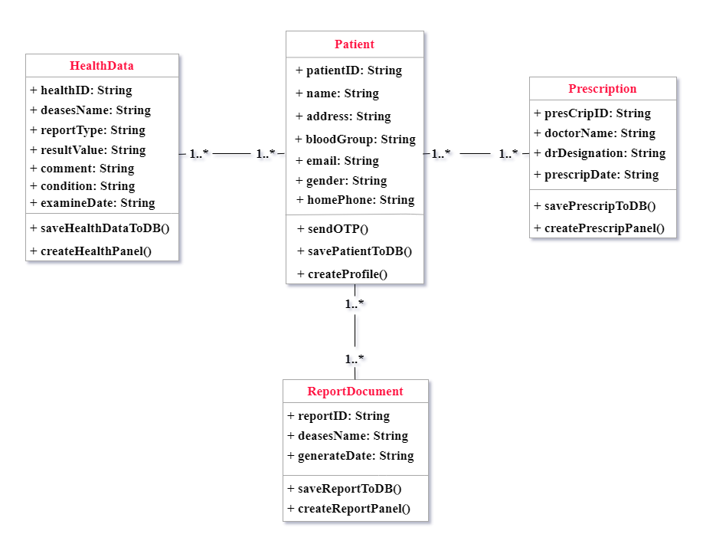
Figure 3.4 Class Diagram

Slide 12
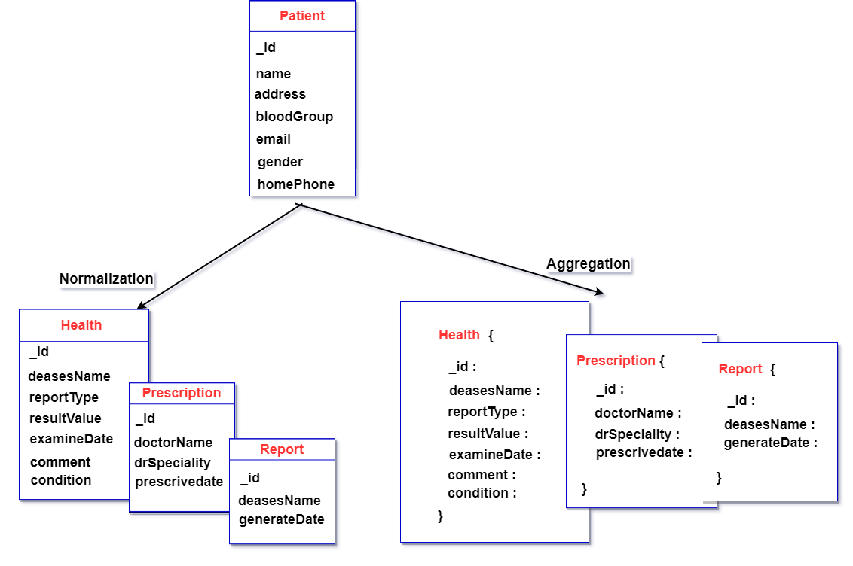
Figure: 3.5 Database Scheme

Slide 13
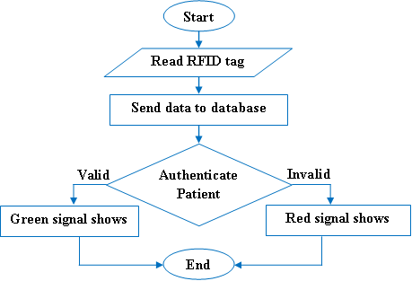
Figure: 3.6 working flow chart

Slide 14
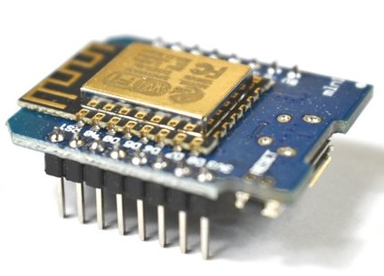
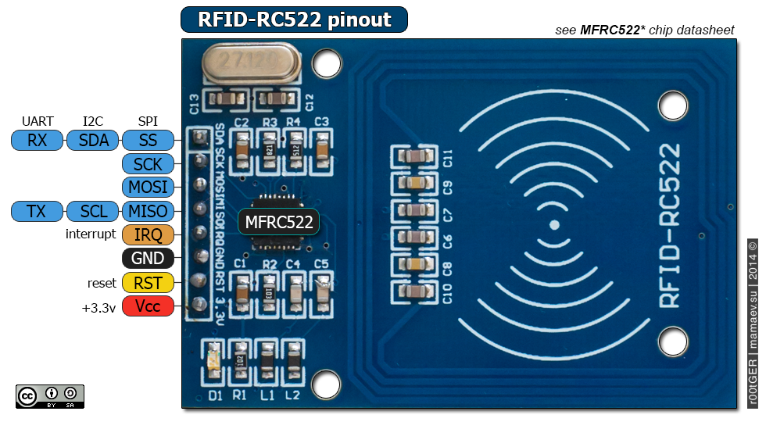
Figure 3.7 WeMos D1 mini ESP8266 Micro Controler
Figure 3.8 RFID MFRC522

Slide 15
Implementation
System Module:
Systematically organized different stages of the research in conjunction with the detailed implementation features of the proposed system it clarifies the structural components of the proposed system and their integration to achieve the research aim.

Slide 16
Implementation
Database Design
Firebase integrated Database.
Data is stored as JSON and fully synchronized in real-time to every connected client.
When data handled over microcontroller, that’s update our android apps also real time within JSON data, which is the fastest data preprocess decode script.

Slide 17
Implementation
App Design
The design should be simple, easy, communicating friendly with organized user-friendly interface .
app design portion:
Admin
Authentication
Users (Patients/Guest)

Slide 18
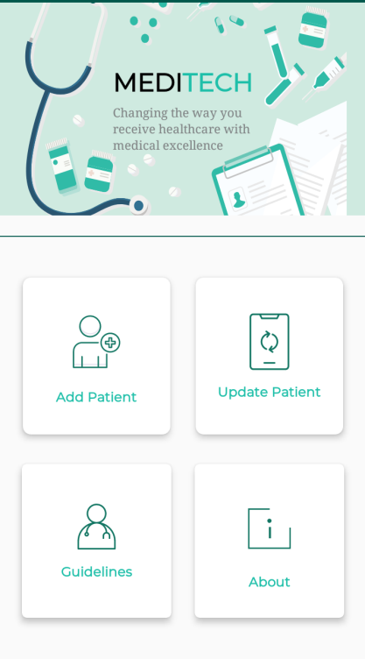
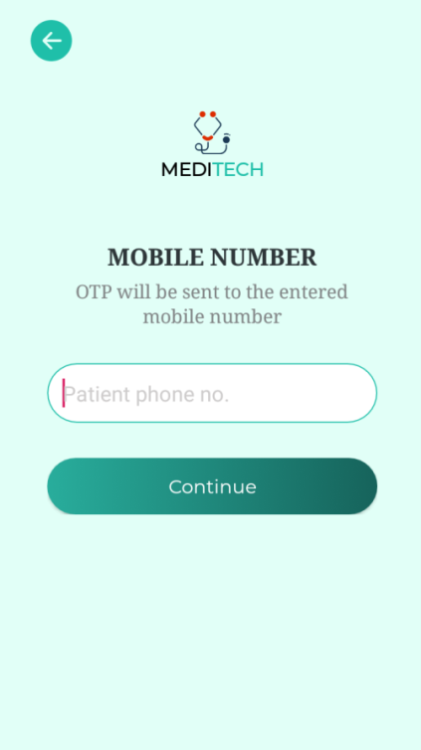
App Design
Admin
Admin dashboard.
admin can add any user manually with OTP.

Slide 19
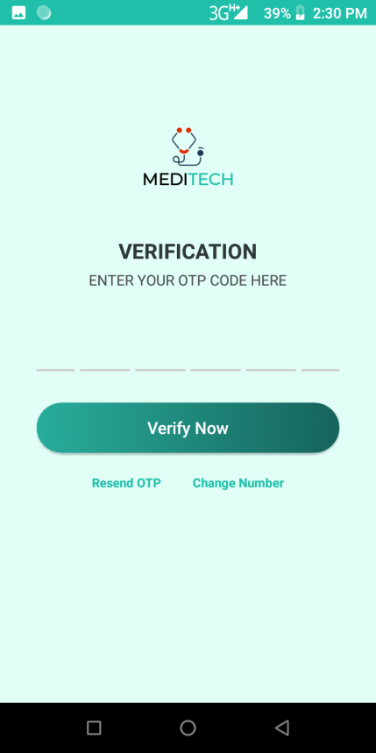
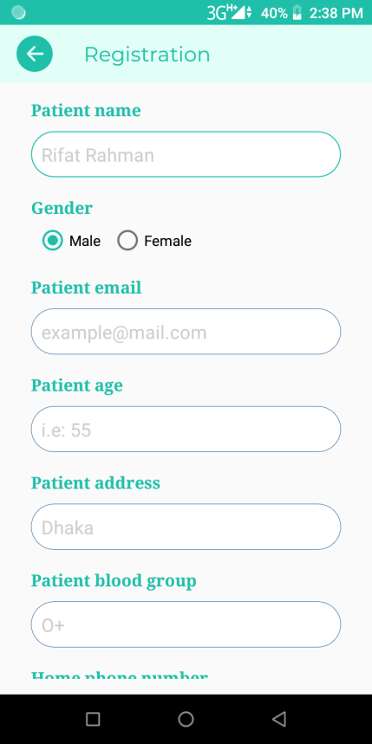
App Design
Admin
User Identity confirmation with OTP code.
Updating users information.

Slide 20
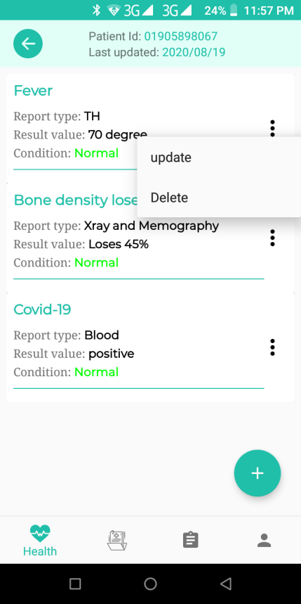
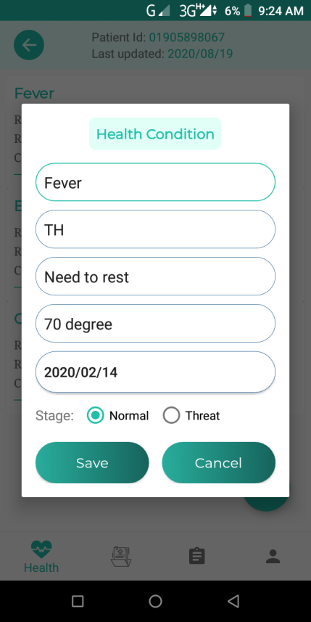
App Design
Admin
data manipulation and maintenance.
Admin has highest Access control.

Slide 21
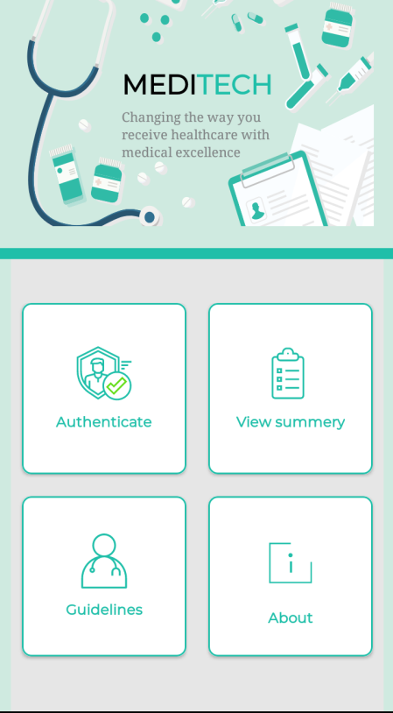
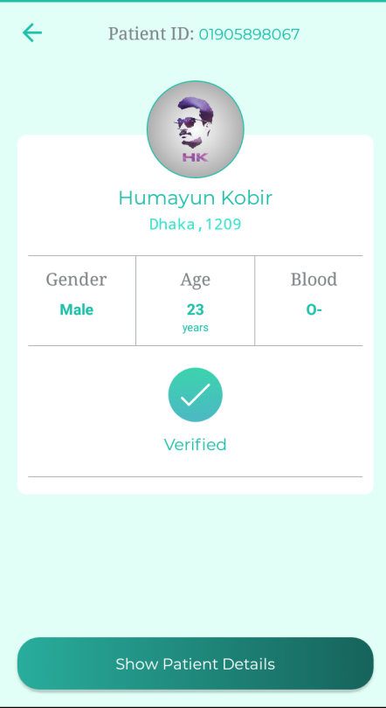
App Design
Authentication
Patient dashboard after having a successful registration.
patient profile after the verification.

Slide 22
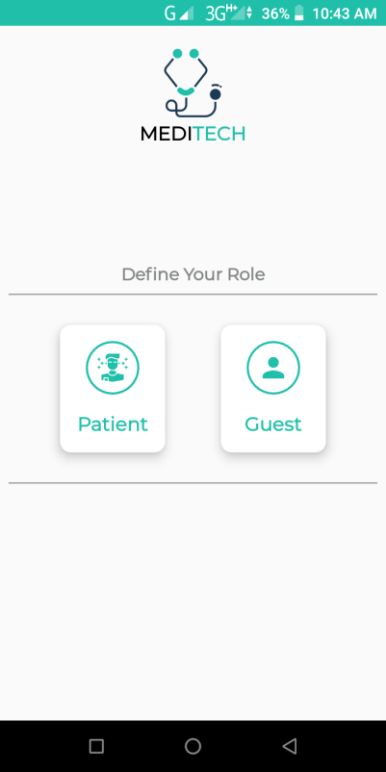
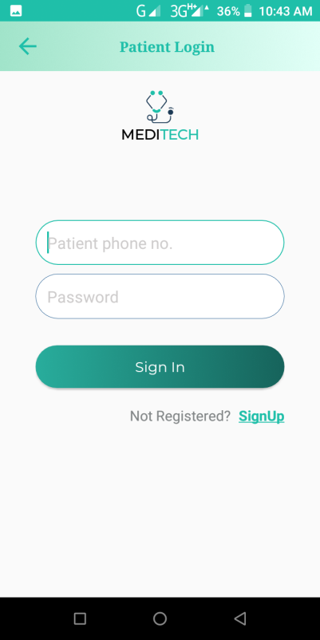
App Design
Users
(Patients/Guest)
dashboard panel for a guest or unregister users.
only admin can register an user after completing his verification through his authentic information.

Slide 23
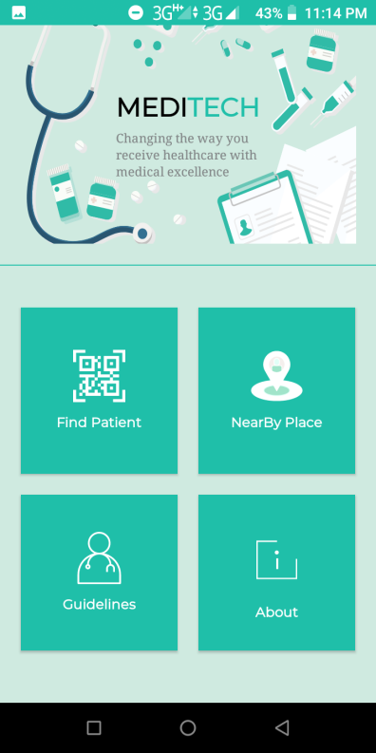
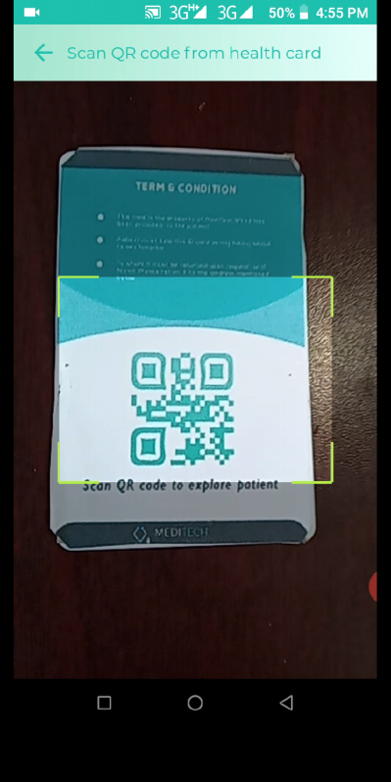
App Design
Users
(Patients/Guest)
Guest user can find the nearby hospitals and pharmacies location after scanning the health card in case of emergency.

Slide 24
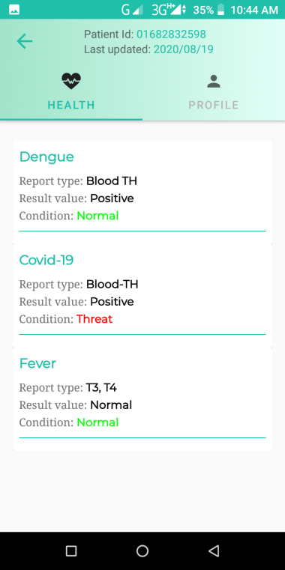
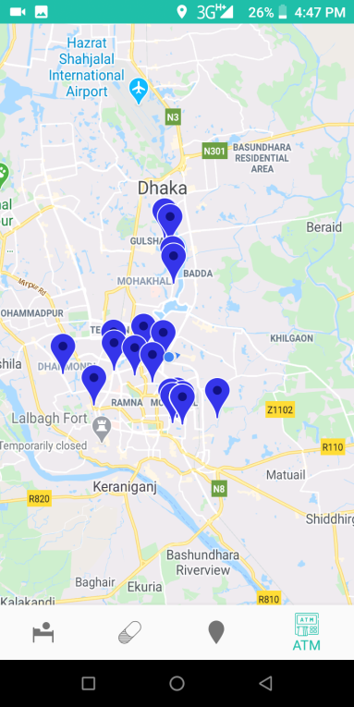
App Design
Users
(Patients/Guest)
Patient Info after scanning.
nearby emergency location

Slide 25
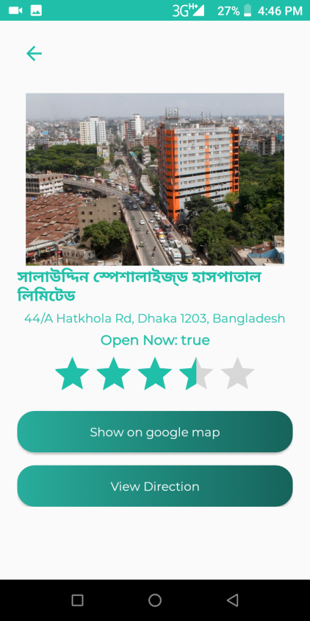
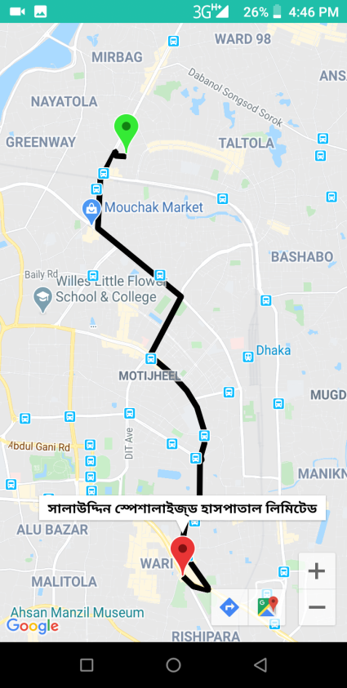
App Design
Users
(Patients/Guest)
Rating on services.
root plan and exploring.

Slide 26
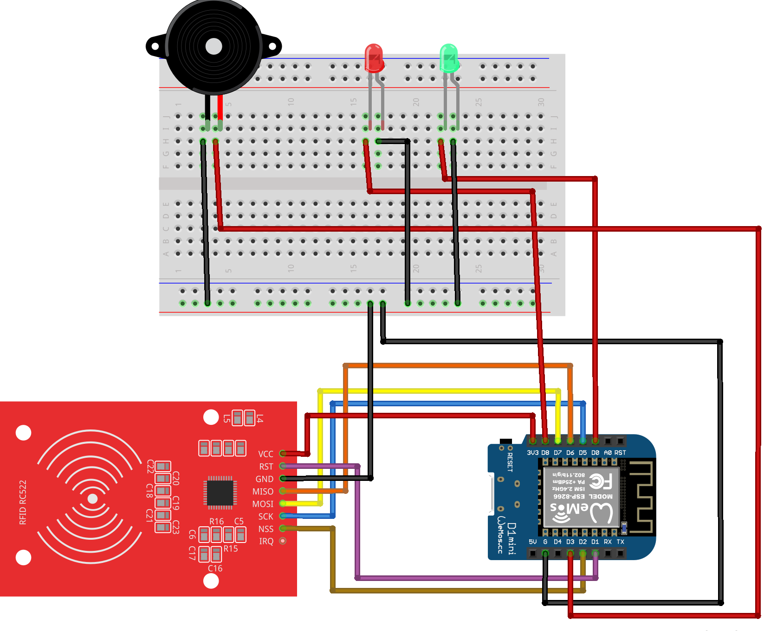
IOT implementation
Node MCU
Breadboard, Jumper wires
LED
Microcontroller (Node-MCU R1 D1 Mini)
RFID Rc-522
resistor 470k/10k
GPIO Breakout board
Ribbon cables

Slide 27
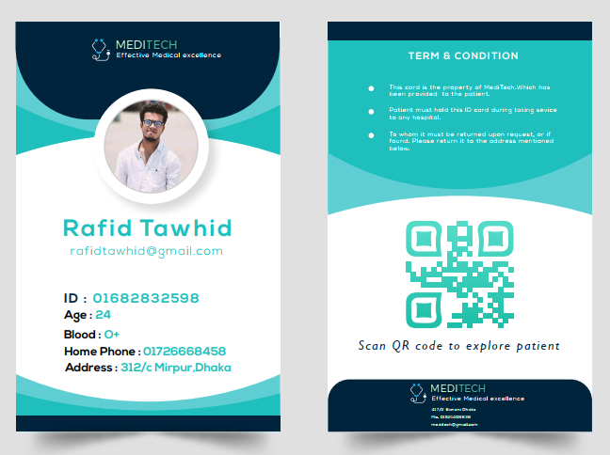
Health Card Demo
Demo health card one can easily scanned this card and get the basic information.
This Card is the label version of system RFID card.

